Slide 1
Oracle Lesson 5
Single-Row Functions:
Conversion Functions
Notes:
*
07/16/96
*
##

Slide 2
Understanding Functions
Input
Output
Function
Function performs
the operations
Parameter 1
Result
Value
Parameter 2
Parameter n
Notes:
*
07/16/96
*
##

Slide 3
Two types of SQL functions
Function
one
row
Single-row
functions
many
rows
Multiple-row
functions
Notes:
*
07/16/96
*
##

Slide 4
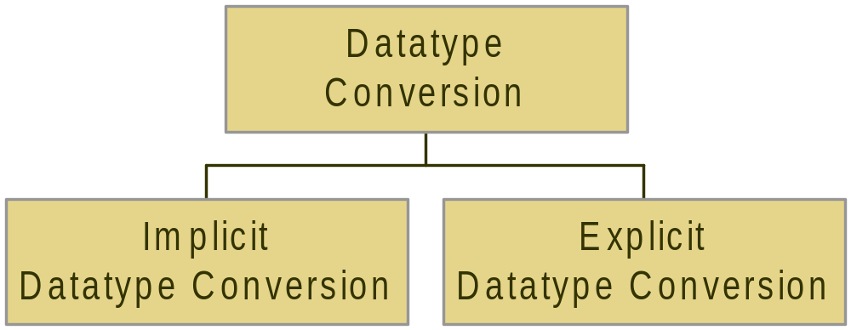
Conversion functions
Done by the
User/developer
(recommended)
Done by Oracle
Server
Notes:
*
07/16/96
*
##

Slide 5
Explicit datatype conversion:
TO_CHAR(number|date [,fmt])
  Displays a number or a date in a more readable format
TO_NUMBER(char [,fmt])
TO_DATE(char [, fmt])
  Converts a character string to a number or date
Notes:
*
07/16/96
*
##

Slide 6
Date format model http://ss64.com/ora/syntax-fmt.html
YYYY
Full year in numbers
YEAR
Year
Year spelled out
MM
2-digit value for month
MONTH
Month
Month spelled out
MON
3-letter month
DDD or DD or D
Day of year, month, or week (numeric) (1=Sunday)
RRRR or RR
Year – 0 – 49 uses current century
50 – 99 uses previous century
DAY or Day
Full name of the day
Notes:
*
07/16/96
*
##

Slide 7
EXAMPLE 1:
SELECT TO_CHAR(hire_date, 'Month DD, YYYY') AS “Date Hired” FROM employees
WHERE job_id LIKE ‘IT%’;
Date Hired
--------------------------------------------------
January 03, 1990
May 21, 1991
June 25, 1997
February 05, 1998
February 07, 1999
Notes:
*
07/16/96
*
##

Slide 8
Now try out each of the following options:
‘fmMonth DD, YYYY‘
'Month DD, YYYY HH:MI p.m.’
'Month DD, YYYY HH24:MI '
‘DDD'
Note: ‘fm’ removes leading zeroes and spaces
Notes:
*
07/16/96
*
##

Slide 9
TO_CHAR function with numbers
9 one digit
0 leading zeros displayed
$ floating dollar sign (or L)
. decimal point (or D)
, comma (or G)
S sign (+ or -) in front
Notes:
*
07/16/96
*
##

Slide 10
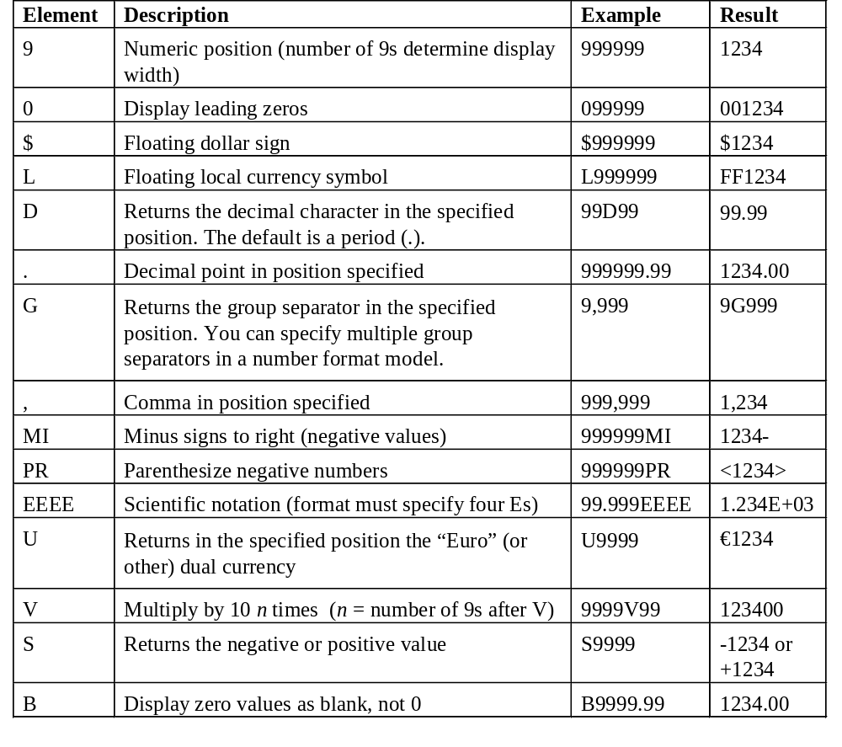

Slide 11
SELECT TO_CHAR(salary, ‘L99G990D00’)
FROM employees;
SALARY
-----------
$800.00
$1,600.00
$1,250.00
$2,975.00
Notes:
*
07/16/96
*
##

Slide 12
TO_DATE function
SELECT last_name FROM employees
WHERE hire_date = ‘April 21, 2000’;
*
ERROR at line 2:
ORA-01858: a non-numeric character was found where a numeric was expected
Notes:
*
07/16/96
*
##

Slide 13
TO_DATE function
SELECT last_name FROM employees
WHERE hire_date =
TO_DATE(‘April 21, 2000’, ‘Month DD, YYYY’);
LAST_NAME
--------------------------
Banda
Kumar
Notes:
*
07/16/96
*
##

Slide 14
The following are equivalent:
TO_DATE(‘18-FEB-07’, ‘DD-MON-YY’)
TO_DATE(’02/18/07’, ‘MM/DD/YY’)
TO_DATE(‘February 18, 2007’, ‘Month DD, YYYY’)
They do the same thing—convert the string that LOOKS like a date into a real DATE (stored internally as 20070218 000000)
Notes:
*
07/16/96
*
##

Slide 15
Summary of explicit datatype conversions:
Function | Data type of value to be converted | Converted data type
TO_CHAR | Number | Character
TO_CHAR | Date | Character
TO_DATE | Character | Date
TO_NUMBER | Character | Number

Slide 16
CASE expression
Similar to IF-THEN-ELSE statement
The expression is compared to comparison string, if they are equal then the result is returned
If the ELSE clause is omitted, a NULL value is returned if no matches are found
CASE expr WHEN comparison1 THEN return1
[WHEN comparison2 THEN return2]
[ELSE else_return]
END
Notes:
*
07/16/96
*
##

Slide 17
Example (equality):
SELECT job_id, salary,
(CASE job_id WHEN ‘IT_PROG' THEN salary * 1.1
WHEN ‘ST_MAN' THEN salary * 1.15
WHEN ‘AD_ASST' THEN salary * 1.20
ELSE salary
END) AS "New salary"
FROM employees;
Notes:
*
07/16/96
*
##

Slide 18
Another example (non-equality):
SELECT last_name, salary,
(CASE WHEN salary < 1000 THEN ‘Low’
WHEN salary < 3000 THEN ‘Mid’
WHEN salary < 5000 THEN ‘High’
ELSE ‘Excellent’
END) AS “Notes”
FROM employees;
Notes:
*
07/16/96
*
##

Slide 19
Nesting functions
Single-row functions can be nested to any level
Innermost function evaluated first
Notes:
*
07/16/96
*
##

Slide 20
SELECT TO_CHAR(NEXT_DAY
(ADD_MONTHS(hire_date, 6), 'FRIDAY'),
‘fmDay, Month ddth, YYYY’)
"Next 6 Month Review"
FROM employees;
This will give you the date of the first Friday that is six
months from the hire date, written in the format
Friday, March 12th, 2007
Notes:
*
07/16/96
*
##

